Slide 1
Implementing toy SIMD Instruction
20202026 - Nguyen Minh Duc
20202027 - Thu Phuong Nguyen

Slide 2
Table of contents
01
SIMD
02
EXPERIMENT
03
RESULTS

Slide 3

01
SIMD
Single Instruction, Multiple Data

Slide 4
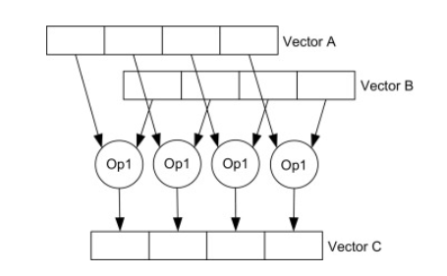
Introduction
SIMD unit executing four operations in parallel
Image credit: https://www.sciencedirect.com/topics/computer-science/single-instruction-multiple-data

Slide 5
Load/ Store
Basic arithmetic operations
Variable permutations
Comparison
What SIMD can do?

Slide 6
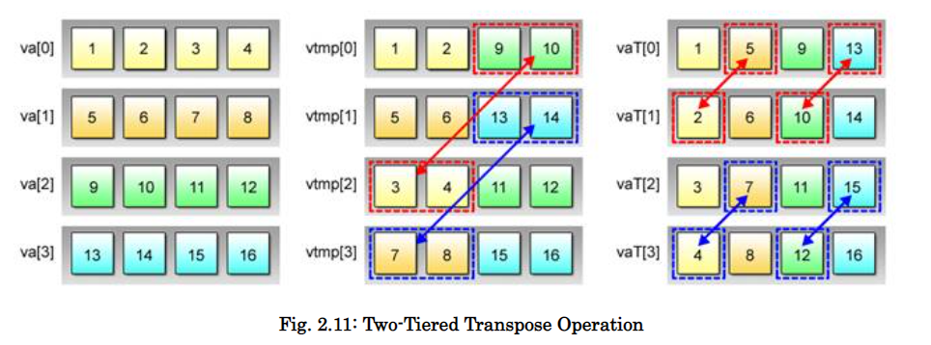
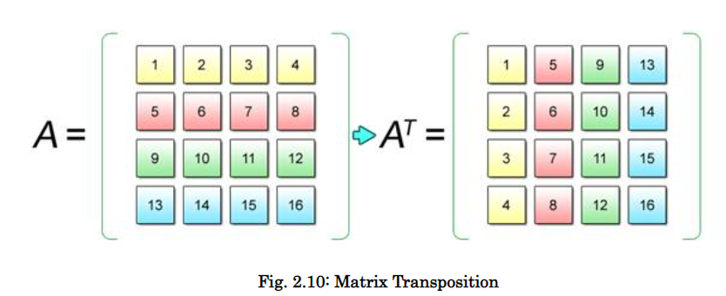
What SIMD can do?
Image Credit: http://ftp.cvut.cz/kernel/people/geoff/cell/ps3-linux-docs/CellProgrammingTutorial/BasicsOfSIMDProgramming.html

Slide 7
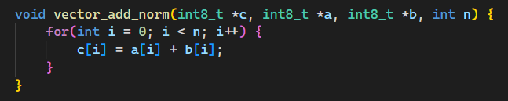
Addition example

Slide 8
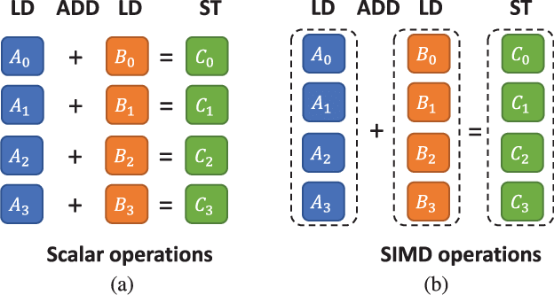
Addition example
Image Credit: https://www.researchgate.net/publication/330140206_Development_of_a_computationally_efficient_voice_conversion_system_on_mobile_phones

Slide 9
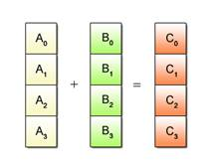
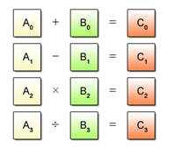
SIMD Restrictions
Image Credit: https://www.researchgate.net/publication/330140206_Development_of_a_computationally_efficient_voice_conversion_system_on_mobile_phones

Slide 10
Our Goal
Task 1
Task 2
Add one instruction: “tvadd”
(Toy vector add)
Perform 8 adds in parallel

Slide 11
02
EXPERIMENT

Slide 12
02 EXPERIMENT
1
2
3
Adding a new instruction
Implementation
Reporting execution

Slide 13
Adding new instruction
1st way
2nd way
Adding a new
“tvadd’ instruction
Modify the existing
“add” instruction

Slide 14
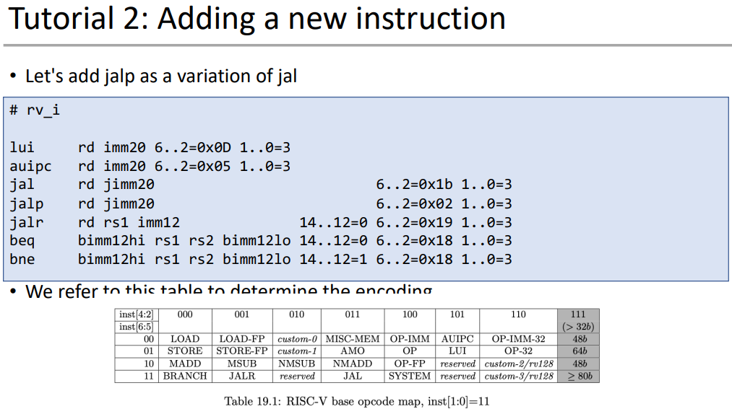
Adding a new "tvadd" instruction
riscv-opcode/rv_i
Credit: Lab3. Implementing Shadow Stack on ISA Simulator

Slide 15
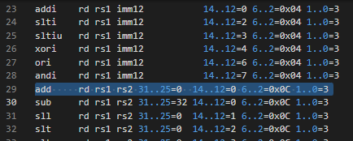
Adding a new "tvadd" instruction

Slide 16
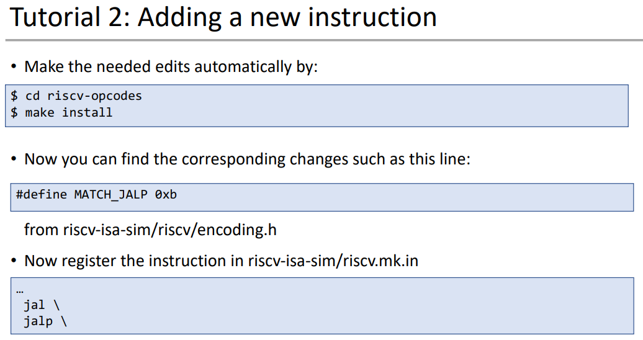
Adding a new "tvadd" instruction
Credit: Lab3. Implementing Shadow Stack on ISA Simulator

Slide 17
2
IMPLEMENTATION

Slide 18
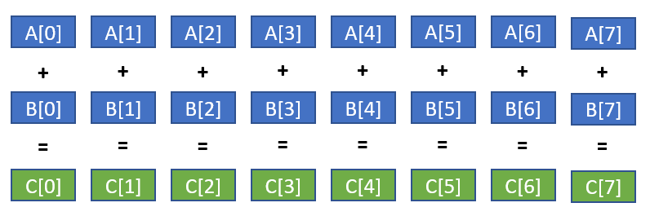
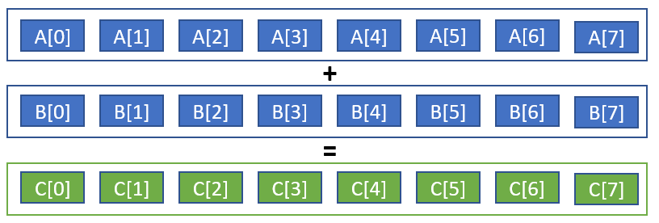
Modyfing existing "add" instruction
Use 64-bit register to load 8 consecutive elements from an array.

Slide 19
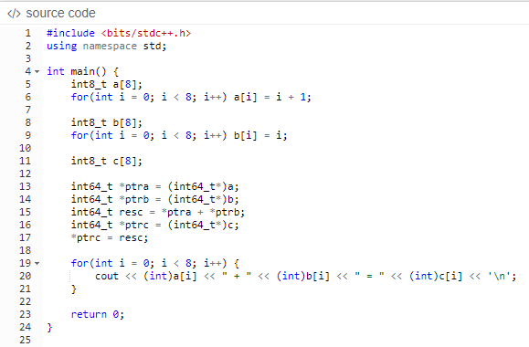
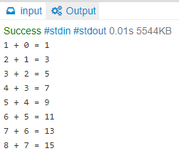
Modyfing existing "add" instruction
Pointers + Type casting
Load/Store multiple 8-bit integers

Slide 20
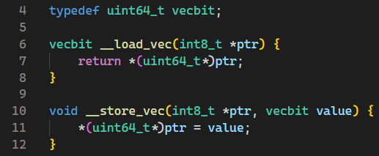
Modyfing existing "add" instruction
Define vector bit type

Slide 21
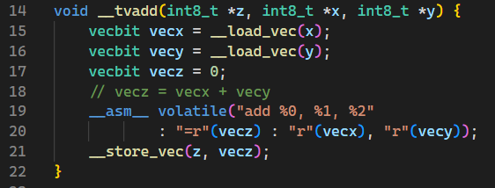
Modyfing existing "add" instruction
Define a tvadd function that invoke assembly code

Slide 22
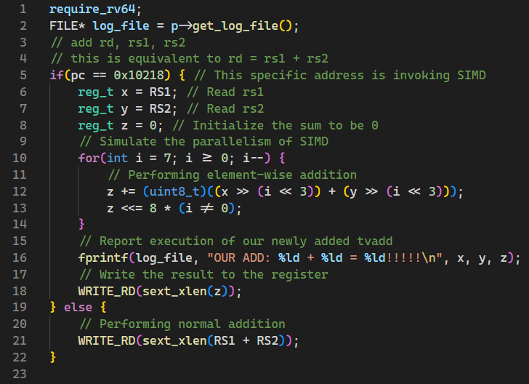
Modyfing existing "add" instruction
Modify the add.h, only use SIMD at a particular address

Slide 23
Modyfing existing "add" instruction
Prevent from adding the carrier to the neighbor number, perform element wise addition.

Slide 24
Reporting SIMD tvadd execution
Task 1
Task 2
Putting some prints inside add.h head file
Explore the log file

Slide 25
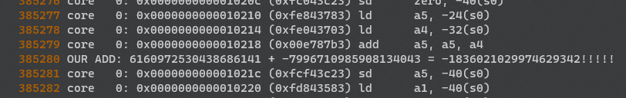
Report SIMD tvadd execution
Explore log file

Slide 26
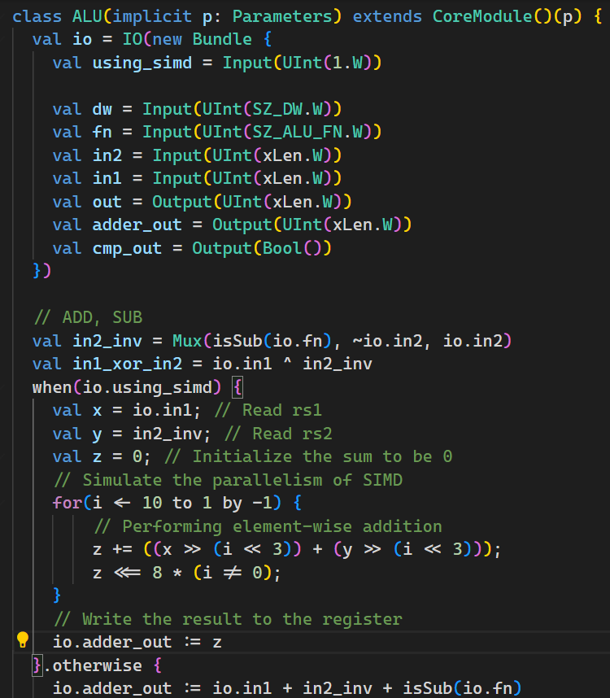
Implement the SIMD to Rocket chip

Slide 27
03
RESULTS

Slide 28
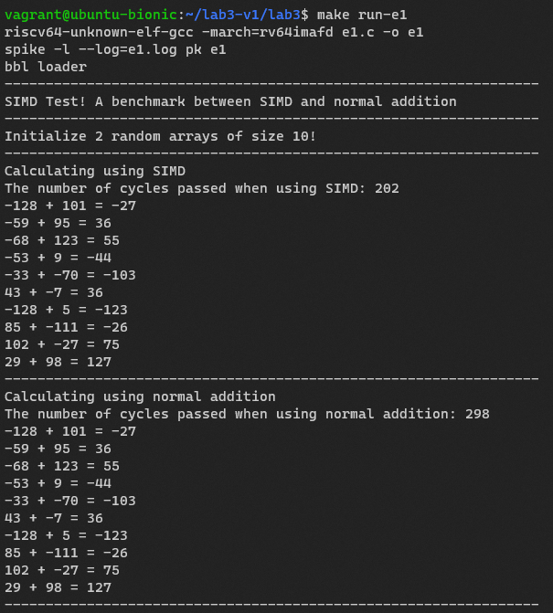
Results

Slide 29
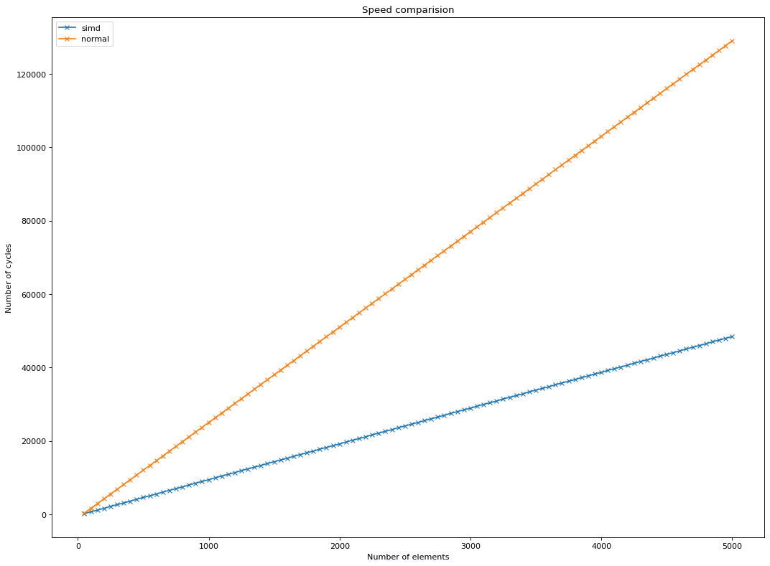
Results
Speed comparison between normal addition and SIMD addition

Slide 30
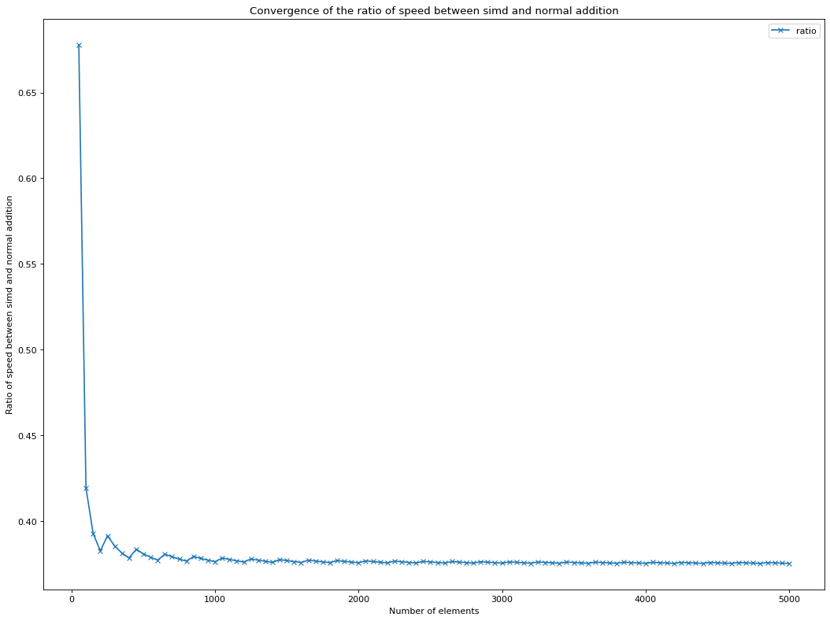
Results
Convergence of the speed between normal addition and SIMD addition

Slide 31

Thank you so much
for your attention!

